Slide 1
Define enzymes
(Enzymes as Biological Catalysts)
Enzymes are proteins that increase the rate of reaction by lowering the energy of activation.
*They catalyze nearly all the chemical reactions taking place in the cells of the body.
*Not altered or consumed during reaction.
*Reusable.

Slide 3
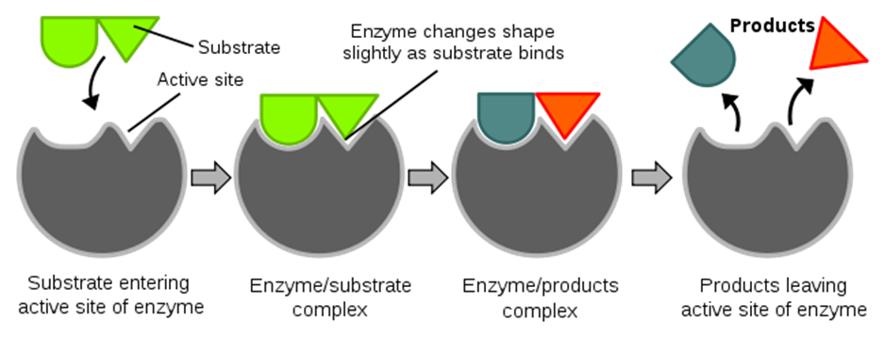

Slide 4
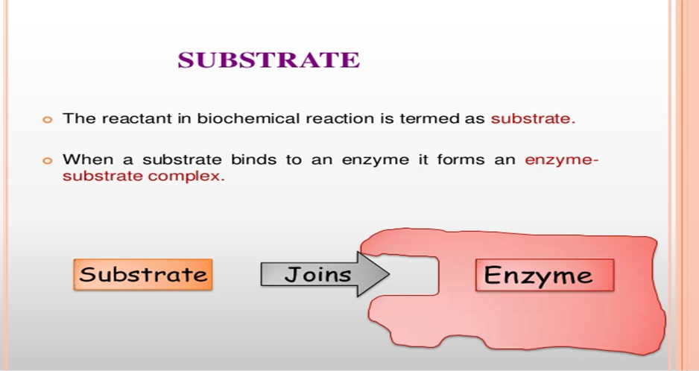

Slide 5
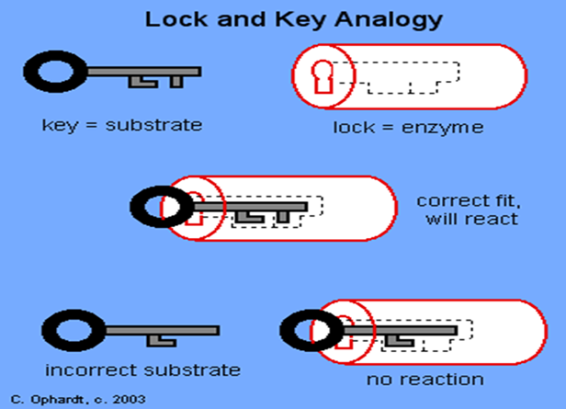

Slide 6
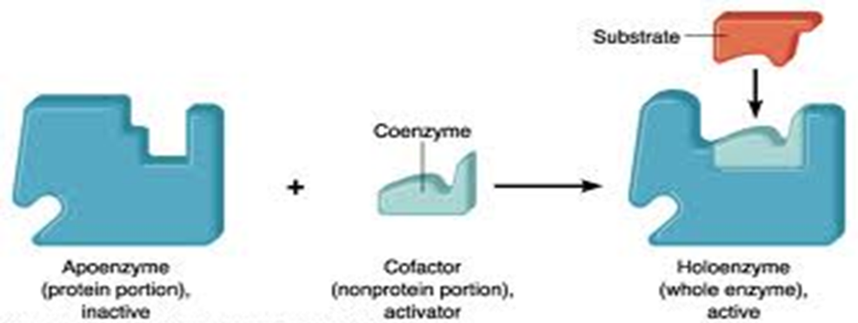

Slide 9
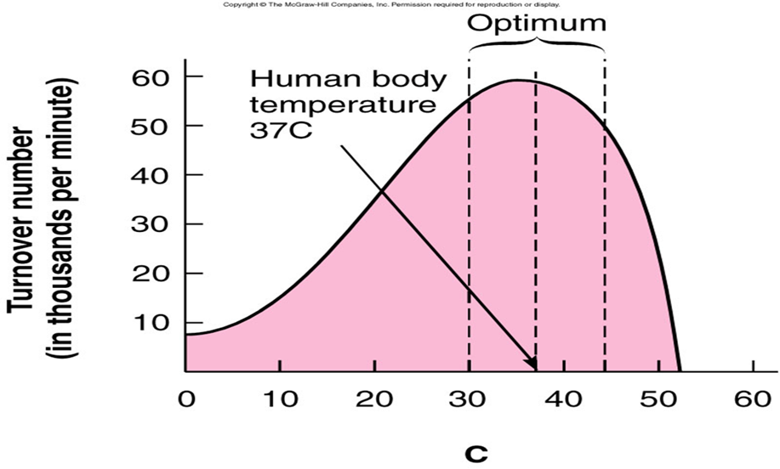
Environmental factors

Slide 10
